Slide 1
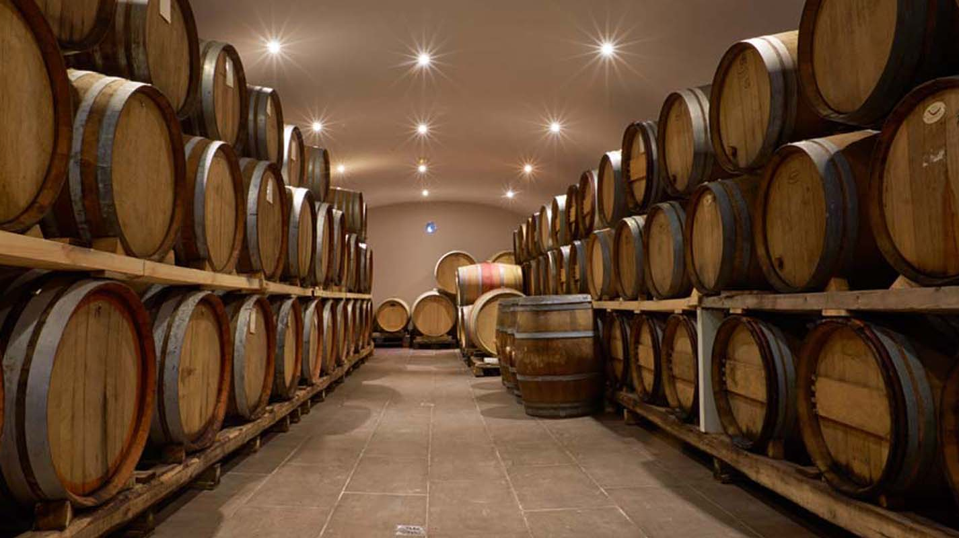


Winery Database
Alexander George, Janani Kumar, Lauren Califano
INFX 543
University of Washington, 2017

Slide 2
Purpose
Develop a database that stores information about Washington State winegrowing regions (AVAs), the grape varietals grown, and wine prices. Our goal is to educate wine consumers about WA State grapes and the wines they produce, while providing winery and price comparisons.

Slide 3
Business Problems Addressed
Maintain a record of Washington State American Viticultural Areas (AVAs), including each AVA’s size in acres and grape varietals grown.
Enable wine customer, business or individual, to search by wine brand or grape varietal and compare prices based on glass, bottle, or case, including winery club discounts.

Slide 4
Business Rules
Price data should be specified per bottle, case and/or per glass.
Include at least one varietal per AVA.
Varietals should be designated as a white or red grape.
Contact information for each winery and customer should be included.
Acreage must be included for each AVA.
Database design should allow for derived information, such as average prices per bottle or varietal, ratios of winery per AVA, etc.
Only wines made from grapes grown in Washington State should be included.
Names of vineyards should be included in this database, and must belong to an AVA.

Slide 5

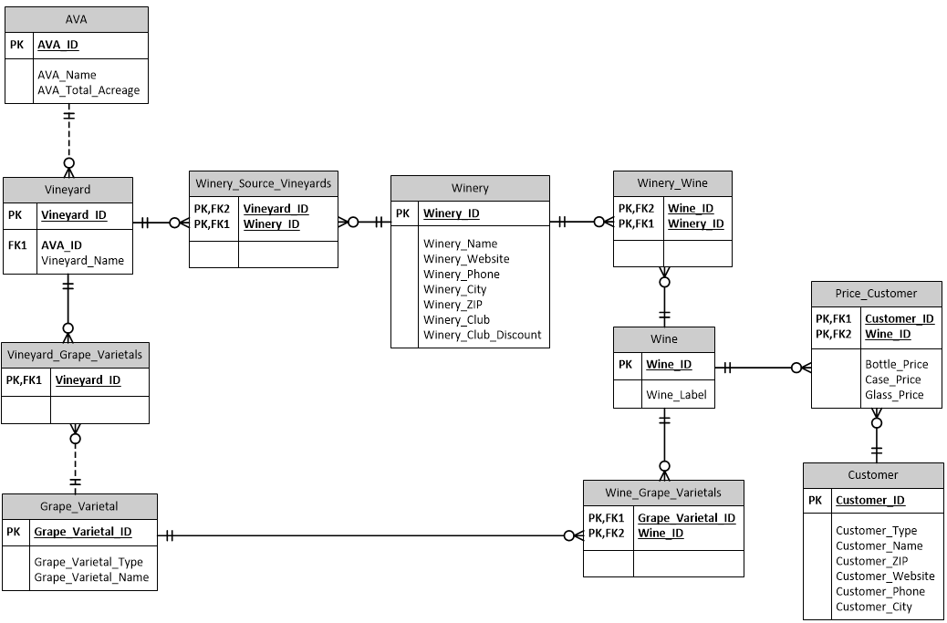

Entity Relationship Diagram

Slide 6
Database Implementation (SQL)

Slide 7
Sample Views
--To extract customer names and the wines they sell with their prices
create view View1 as
Select c.customer_name, p.wine_id,p.Bottle_Price,p.Case_Price,p.Glass_Price
from customer c inner join price_customer p
on c.Customer_ID=p.Customer_ID
--To view customer names with the wine labels they sell and the prices
create view view2 as
select v.customer_name,w.wine_label,v.bottle_price,v.case_price,v.glass_price
from View1 v inner join Wine w on v.Wine_ID=w.Wine_ID

Slide 8
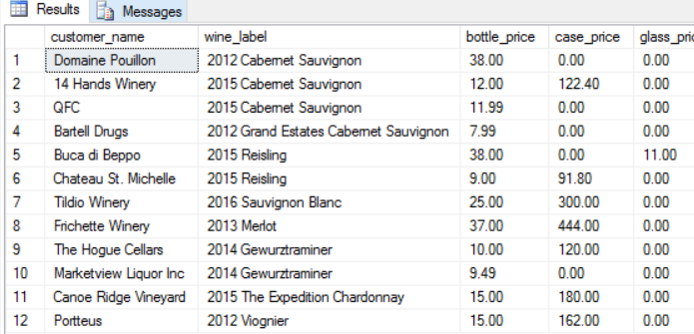
Reports
Ability to query customer, wine, and price data.

Slide 9
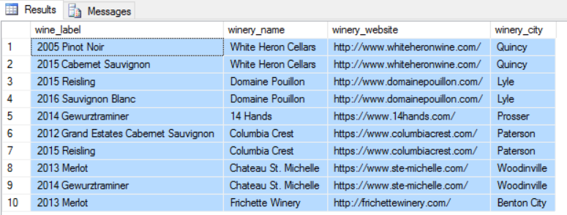
Reports
Search for winery by name, label, or location.

